Slide 1
Database spelunking
Exploring without light….

Slide 2
The hardest thing about writing SQL is figuring out the database relationships.

Slide 3
Finding SQL Server instances
Just ask SQL Server Browser
  Use PowerShell
    [System.Data.Sql.SqlDataSourceEnumerator]::Instance.GetDataSources()
  Command prompt
    Sqlcmd -L
Only shows instances within a domain
Only shows instances current login has permissions to see
SQL Browser services must be running

Slide 4
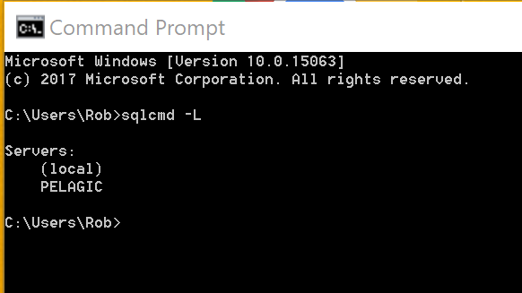
From Command Prompt

Slide 5
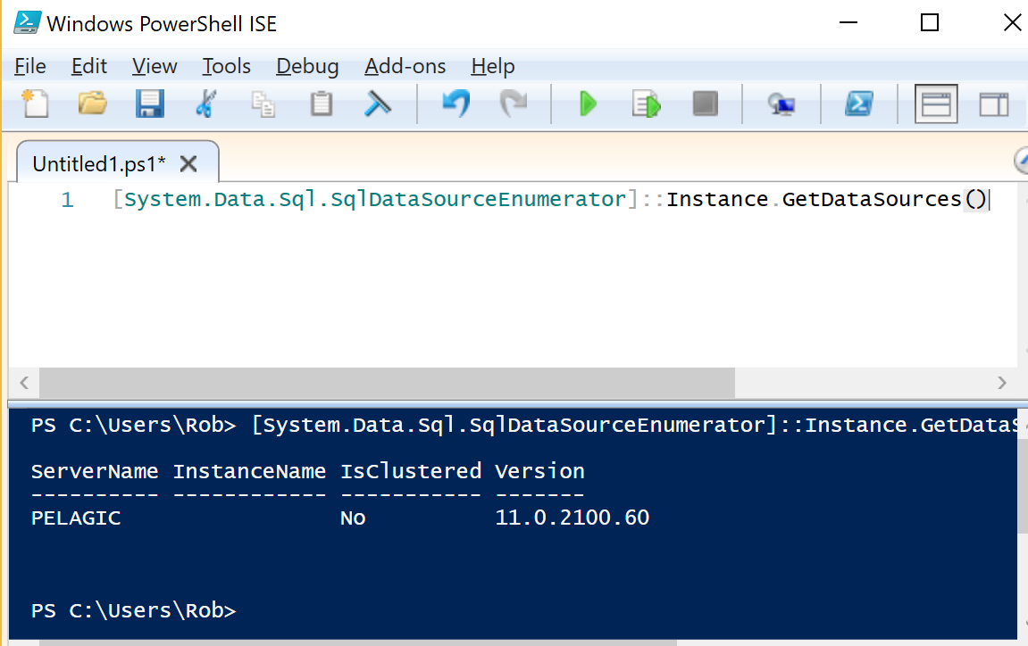
From PowerShell

Slide 6
Relational databases store database designs in a database
ANSI
  INFORMATION_SCHEMA
Microsoft
  SYS Schema

Slide 7
List databases with an instance
Query SYS schema
  select * from sys.databases
Query INFORMATION_SCHEMA
  INFORMATION_SCHEMA doesn’t have a Database object

Slide 8
Find a table by name
In a specific database
  Use Management Studio
  Query SYS schema
    select * from sys.tables where [name] like '%log%‘
  Query INFORMATION_SCHEMA
    select * from INFORMATION_SCHEMA.tables where TABLE_NAME like '%log%'
In a specific instance
  SYS and INFORMATION_SCHEMA have database scope (mostly)
    You can only search one database at a time
  Use TSQL
    Build a cursor of databases, loop to query sys.tables
    Sample file: findTableInInstance.sql
Across multiple instances
  Use PowerShell
    Loop through instances using System.Data.SqlClient to create separate connection for each instance.
    Sample file: findTableInInstanceList.ps1

Slide 9
Find a column by name
In a specific database
  Use Management Studio
  Query SYS schema
    use AdventureWorksDW2012
    select t.name, c.name from sys.columns c inner join sys.tables t
    on t.object_id = c.object_id
    where c.[name] like '%Reseller%'
In a specific instance
  SYS and INFORMATION_SCHEMA have database scope (mostly)
  Use TSQL
    Build a cursor of databases, loop to query sys.tables
    Sample file: findColumnWithinInstance.sql
Across multiple instances
  Use PowerShell
    Loop through instances using System.Data.SqlClient to create separate connection for each instance.

Slide 10
Find a string in any stored procedure in a database
select distinct OBJECT_NAME(id)
from syscomments
where OBJECTPROPERTY(id, ‘IsProcedure’) = 1
and [text] like ‘%categoryID%’
order by OBJECT_NAME(id)

Slide 11
Find a string in any view in a database
use AdventureWorks2012
select distinct OBJECT_NAME(id)
from syscomments
where OBJECTPROPERTY(id, 'isView') = 1
and [text] like '%emp%'
order by OBJECT_NAME(id)

Slide 12
Find actual Foreign Key relationships
USE AdventureWorks2012;
GO
SELECT
f.name AS foreign_key_name
,OBJECT_NAME(f.parent_object_id) AS table_name
,COL_NAME(fc.parent_object_id, fc.parent_column_id) AS constraint_column_name
,OBJECT_NAME (f.referenced_object_id) AS referenced_object
,COL_NAME(fc.referenced_object_id, fc.referenced_column_id) AS referenced_column_name
,is_disabled
,delete_referential_action_desc
,update_referential_action_desc
FROM sys.foreign_keys AS f
INNER JOIN sys.foreign_key_columns AS fc
ON f.object_id = fc.constraint_object_id
WHERE f.parent_object_id = OBJECT_ID(‘Production.BillOfMaterials');

Slide 13
Find potential Foreign Key relationships
Build a cursor of tables & columns
For each table
  Build a cursor of columns
  For each column
    Concatenate a list of tables with that column name
Sample file: findColumnWithinInstance.sql

Slide 14
Profile a table
Build a cursor of columns for specified table
For each column
  Count number of records, unique values, null values
  Concatenate a list of field values for column
Sample file: ProfileTable.sql

